Slide 1
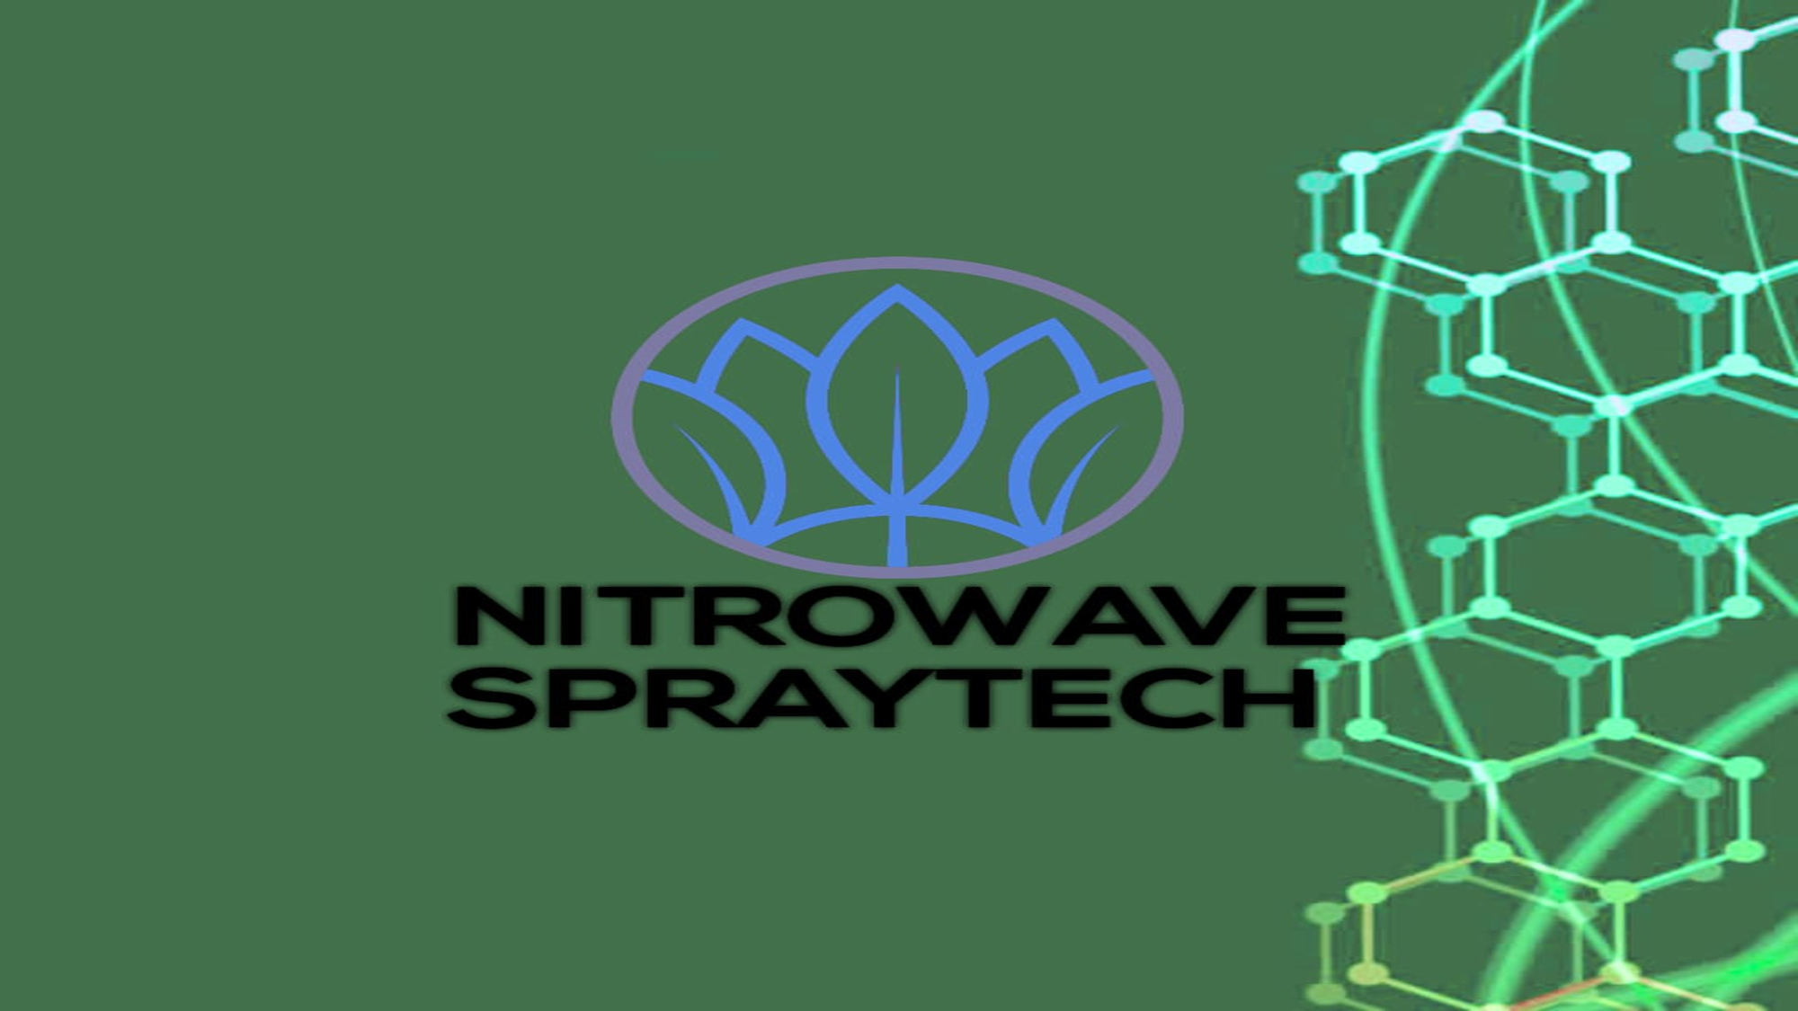
Revolutionizing Surface Coating

Slide 2
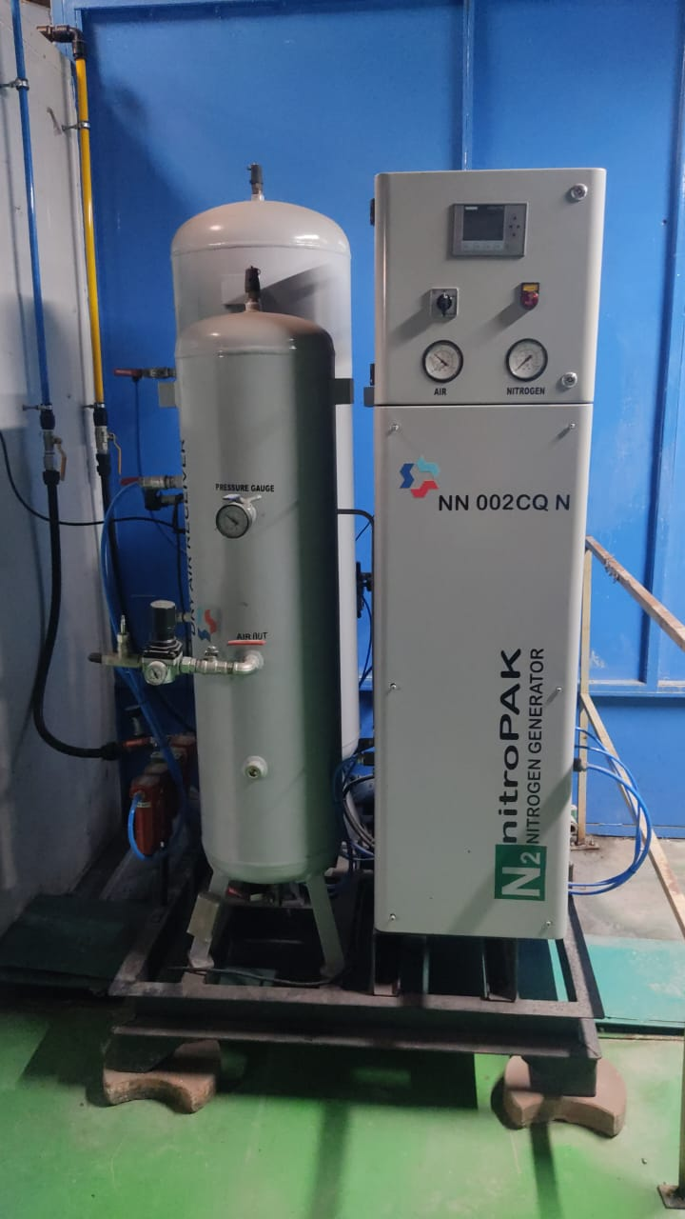
Introduction
The process of paint preparation with ultrasonic cavitation with assistance of ionized heated nitrogen to build a uniform coating thickness in one single coat by which we can reduce thinner consumption drastically and save our environment.
Ultrasonic cavitation increases temperature of paint and ionized heated nitrogen confirms the reduction in viscosity of paint which when fall on surface to be coated forms a smooth uniform layer having improved paint film properties.

Slide 3
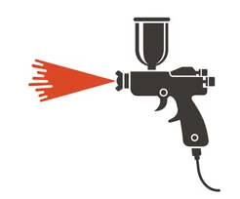
How It Works
COMPRESSED AIR
AIR DRYER
NITROGEN GENERATOR
RESERVOIRE
IN LINE AIR HEATING UNIT
IONISER UNIT
ULTRASONIC CAVIATOR
HEATED PAINT
PAINT APPLICATION SPRAY GUN

Slide 4
Components
Nitrogen generator-
why nitrogen--- nitrogen is anhydrous and inert gas having same particle size .
Heating unit –
Nitrogen used as carrier for paint spraying heating the carrier will result in paint viscosity reduction it will help to reduce the thinner intake resulting less backing time, increased DOI , less orange peel and less coats to hide surface as solids of paint will be deliver more in one stroke , VOC reduction will give green benefits.
Ionization unit-
Ionized particle of nitrogen will allow paint particle to adhere the surface and control variation of temperature and humidity.
Ultrasonic caviator-
Caviator mixes paint uniformly heats the paint as there is a cascading effect of particles results in viscosity reduction.

Slide 5
Spray painting with nitrogen
Spray painting with nitrogen is a technology that has gained popularity in recent years due to its numerous benefits over traditional compressed air. The primary advantage of using nitrogen-enriched air is its significantly reduced impurities compared to compressed air. This results in fewer harmful emissions in the work space, a higher gloss finish with fewer coats and less sagging and dripping, and a reduction in orange peel, which saves considerable time spent fixing this flaw later.
The process of spraying with nitrogen involves an in-line nitrogen source located between a shop's compressed air supply and its spray guns. The system pulls nitrogen out of the atmospheric air, which is then filtered and heated to produce a high-purity nitrogen stream. This stream is then ionized and heated before being used for spraying. The use of nitrogen-enriched air does not require any special spraying techniques, but painters should be aware that they will need to apply less finish than they previously needed.

Slide 6
What are the benefits of using nitrogen for spray painting
The use of nitrogen for spray painting offers several benefits over traditional compressed air. These advantages include:
Improved Paint Quality: Nitrogen is an inert gas that does not contain moisture, which reduces flash times, decreases bake times, and ultimately improves cycle time. This results in a higher gloss finish with fewer coats and less sagging and dripping.
Reduced Solvent Levels: Nitrogen-enriched air significantly reduces solvent levels, which helps eliminate orange peel, saving considerable time spent fixing this flaw later.
Increased Efficiency: Nitrogen is cleaner, dryer, and atomizes more effectively than compressed air. This results in better transfer efficiency, reducing overspray by about 50 percent and filters in the spray booth lasting 40 percent longer.
Cost Savings: The use of nitrogen can lead to significant savings in paint consumption, with some shops reporting up to 30% reduction in paint usage.

Slide 7
Environmental Benefits: Nitrogen is a more environmentally friendly option as it reduces VOC emissions by up to 50% and eliminates the need for solvents.
Consistent Performance: Nitrogen provides consistent performance in all weather conditions, unaffected by temperature and humidity, ensuring a high-quality finish regardless of environmental conditions.
Reduced Maintenance: The use of nitrogen reduces the need for maintenance on spray guns and booths due to the elimination of oil, oil fumes, and dust.
Improved Safety: Nitrogen is a safer option as it eliminates the risk of fire and explosion associated with compressed air.
Increased Productivity: The use of nitrogen enables shops to increase their productivity by reducing the time spent on painting and improving the overall efficiency of the painting process.
Better Coating Uniformity: Nitrogen ensures a uniform coating by providing a perfect mill build—a solid layer of paint. This results in fewer coats needed for a job and less waste.

Slide 8
safety precautions when using nitrogen for spray painting
In case of nitrogen leaks during spray painting, it is essential to follow these safety measures :
Ventilation: Ensure proper ventilation to disperse the leaked nitrogen gas and prevent its accumulation in the work area.
Evacuation: If a significant nitrogen leak occurs, evacuate the area immediately to prevent exposure to high concentrations of nitrogen gas.
Respiratory Protection: Wear appropriate respiratory protection if needed to avoid inhaling high levels of nitrogen gas.
Emergency Response: Have an emergency response plan in place, including procedures for handling leaks, evacuations, and contacting emergency services if necessary.
Safety Equipment: Ensure that safety equipment, such as gas detectors, is available to detect leaks and monitor nitrogen levels in the environment.

Slide 9
Ionization of nitrogen why necessary before spray painting
The ionization of nitrogen before spray painting is necessary for several reasons:
Improved Transfer Efficiency: Ionization helps improve the transfer efficiency of the paint when it's applied. This is because the electric charge given to the gas helps the paint particles adhere better to the surface, resulting in a more uniform and consistent finish.
Better Paint Adhesion: The ionization process enhances the adhesion of the paint to the surface. This is crucial because it ensures that the paint stays in place without peeling or flaking off, which can lead to a higher quality finish.
Reduced Overspray: Ionization also helps reduce overspray by improving the paint's ability to adhere to the surface. This results in less paint being wasted and less cleanup required.

Slide 10
Enhanced Paint Flow: Ionization can also enhance the flow of the paint, allowing it to be applied more smoothly and consistently. This is particularly important in applications where a high-gloss finish is required.
Increased Productivity: By improving the transfer efficiency and reducing overspray, ionization can increase productivity in the paint department. This is because painters can work more efficiently and complete jobs faster, which can lead to increased profitability.
In summary, the ionization of nitrogen before spray painting is crucial for achieving a high-quality finish, reducing waste, and increasing productivity in the paint department.

Slide 11
What is the process of ionization of nitrogen
The process of ionization of nitrogen involves the removal of one or more electrons from a nitrogen molecule (N2) to form a positively charged ion. This process can occur through various mechanisms, including :
Electron Bombardment: In this process, high-energy electrons from an external source, such as a laser or an electrical discharge, collide with the nitrogen molecules, causing them to ionize.
Ionization Energy: The ionization energy of nitrogen is the energy required to remove an electron from a nitrogen molecule. This energy is higher for nitrogen than for oxygen due to the half-filled p-orbitals in nitrogen, making it more stable.
Laser-Induced Ionization: A strong and short laser pulse can ionize nitrogen molecules by exciting them to higher energy levels, which can then lead to the emission of electrons.

Slide 12
Direct Analysis in Real Time (DART): In this process, a metastable nitrogen species transfers energy to a molecule, such as ammonia, causing it to ionize. The resulting ions are then analyzed using mass spectrometry.
Electron Impact Ionization: This process involves the collision of high-energy electrons with nitrogen molecules, resulting in the removal of electrons and the formation of ions.
Excitation by Excited Nitrogen Molecules: The rate of ionization of nitrogen can be enhanced by the presence of excited nitrogen molecules, which can transfer energy to other nitrogen molecules, causing them to ionize.

Slide 13
Advantages
Viscosity reduction in paint due to heated nitrogen and ultrasonic cavitation results in flatter coat.
Less thinner consumption reduction in voc
Overspray reduction in waste control of paint .
High DFT in single coat
High DOI
Gloss improvement
Clean environment
Less orange peel

Slide 14
Advantages
Exhaust filter clogging and efficiency of filter increase
Production efficiency increases
Due to ionized nitrogen wrap round effect seen wastage of paint reduces
Drying time between two coat reduces by which we can design paint shop in a very small space
Less voc
Two important variable in painting i.e temp and humidity control hence in all season we can achieve identical finish.
Nitrogen as fire fighting unity
Oxygen can be given to painter as fresh air supply

Slide 15
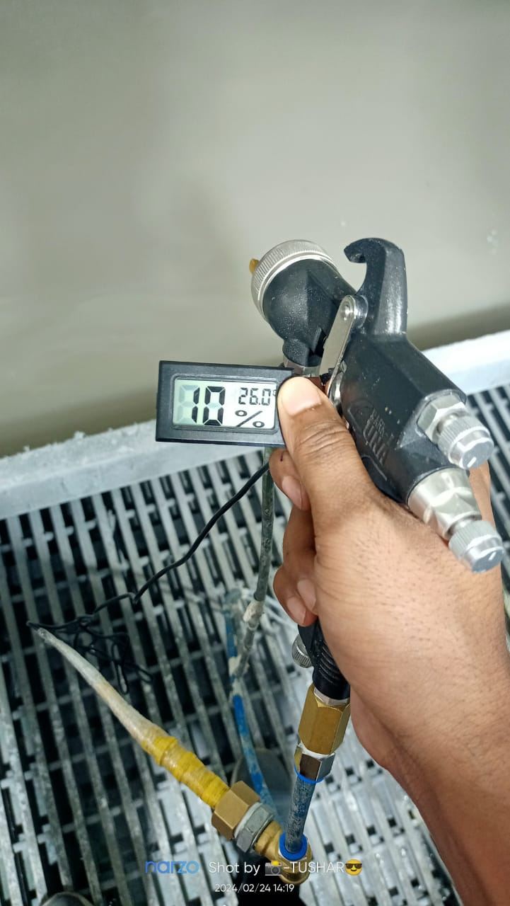
Advantages of Compressed Nitrogen Gas
Getting control over humidity of compressed nitrogen . Consistent humidity of 10% over all weather conditions.

Slide 16
Case Study 1-
Earlier the spoiler paint consumption was 0.291ltr/part at the start of the project. which is not meeting the customer requirement . Customer required minimum 15% reduction in paint consumption.

Slide 17
Spoiler Month wise Paint Consumption rejection
when added nitrogen at one coat then it gets reduced up to 0.197 ltr/part and after addition of heating with ultrasonic caviator it gets reduced to 0.132 ltr/part.

Slide 18
Case Study 2-
Earlier the skid paint consumption was 0.49ltr/part at the start of the project. which is not meeting the customer requirement . Customer required minimum 20% reduction in paint consumption.

Slide 19
SKID paint consumption – white
when added nitrogen at one coat then it gets reduced up to 0.35 ltr/part and after addition of heating with ultrasonic caviator it gets reduced to 0.30 ltr/part.

Slide 20
Questions and Discussion

Slide 21
Thank You

